Slide 1

Project Proposal: Interactive Data Visualization
NYC 311 Service Requests Analysis
Zarish Asim 2022640 Adina Kamran 2022044

Slide 2
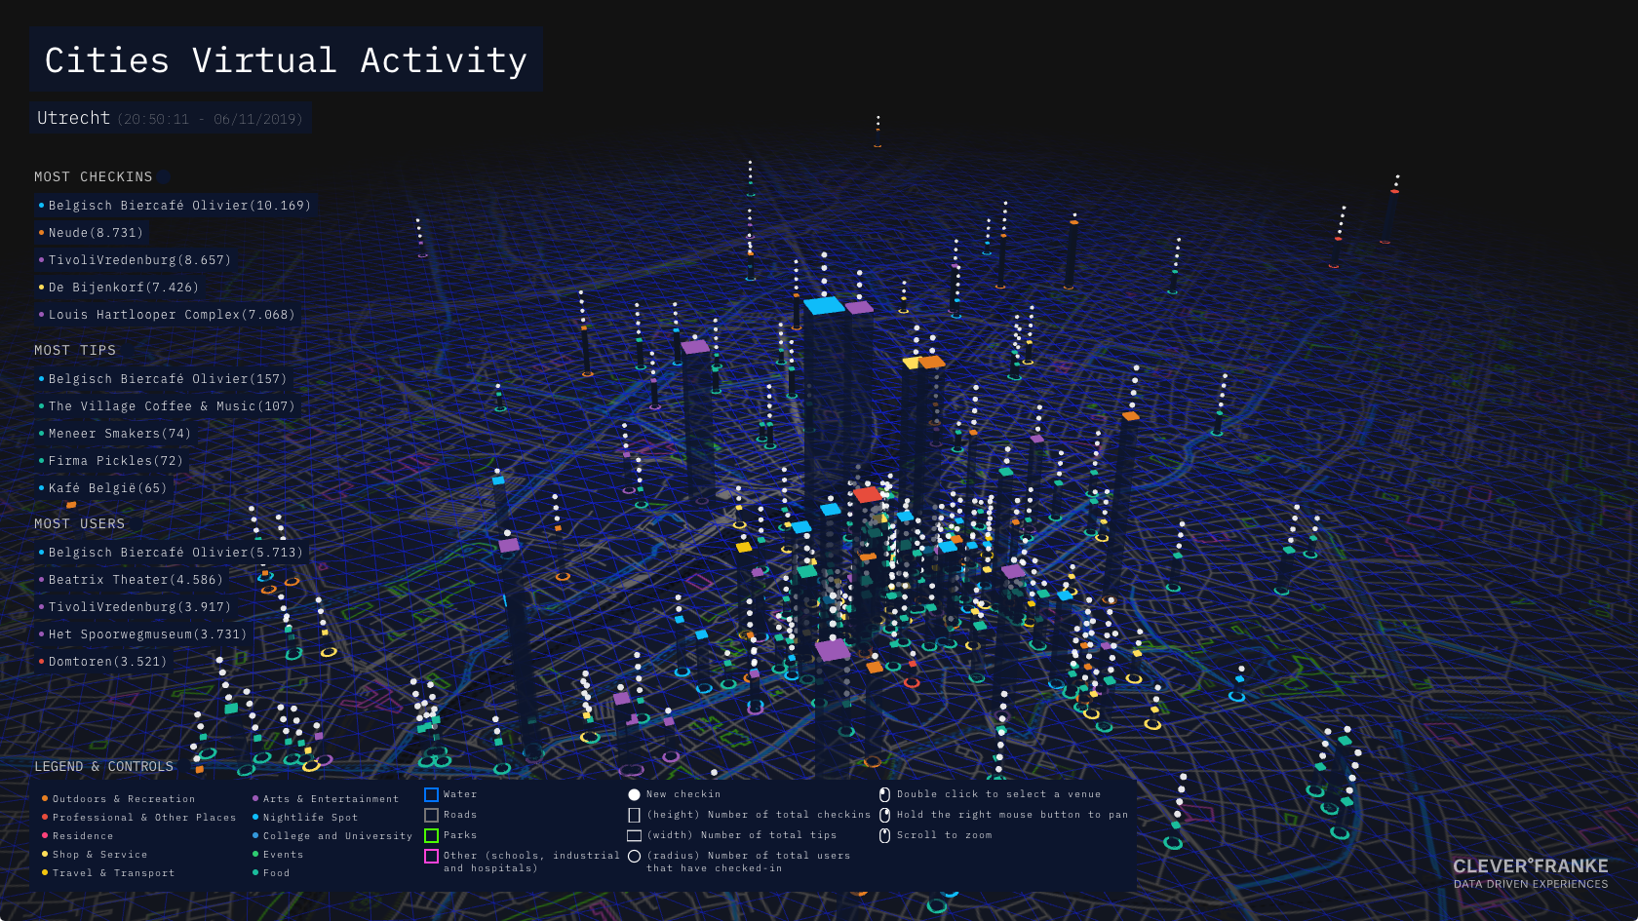

Introduction: Unlocking Urban Data
Modern cities generate vast amounts of data. Data visualization transforms raw datasets into understandable patterns, trends, and relationships, especially for civic data.
Interactive Visualizations
Allow dynamic exploration of data, crucial for civic datasets.
NYC 311 Service Requests
Focuses on non-emergency complaints to understand service demand and citizen behavior.

Slide 3
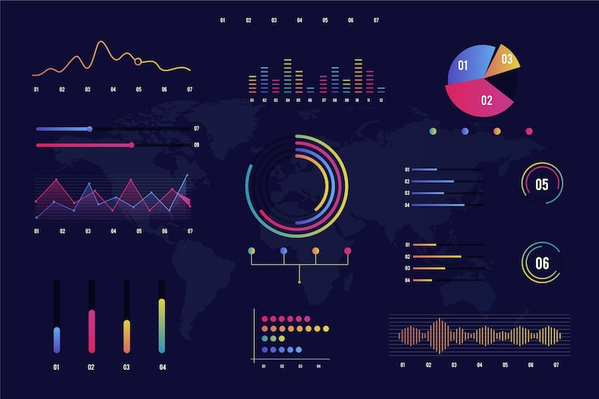
Project Objectives
Our goal is to design and deploy an interactive data visualization system for NYC 311 Service Requests.
1
Analyze Temporal Trends
Examine long-term and short-term patterns in service requests.
2
Geographic Variation
Compare complaint volumes and types across NYC boroughs.
3
Assess Service Resolution
Evaluate operational performance based on complaint status.
4
Identify Behavioral Patterns
Discover peak reporting hours and seasonal effects.
5
Design Interactive Dashboards
Support exploratory data analysis and visual storytelling.

Slide 4
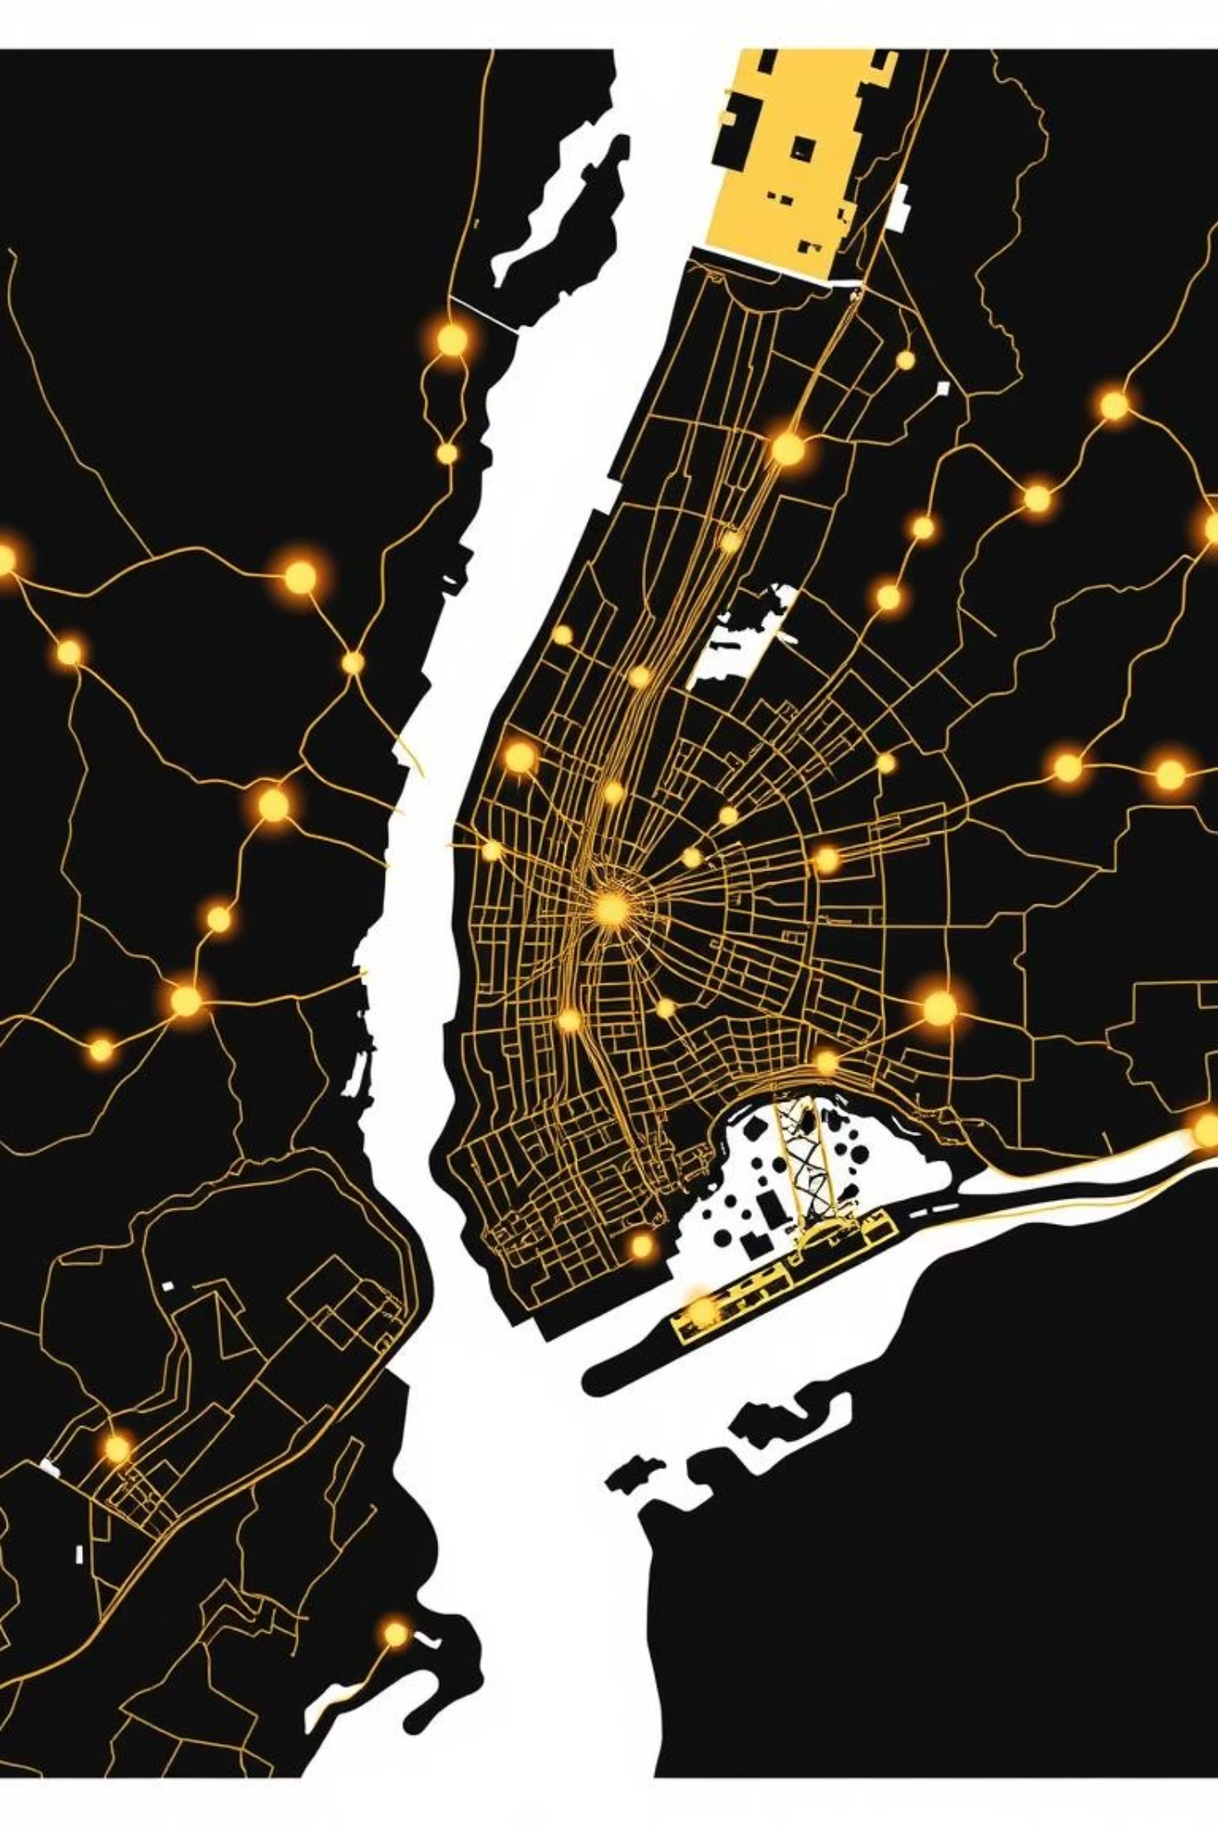
Dataset Description: NYC 311 Service Requests
This publicly available dataset details non-emergency service complaints from NYC residents.
Dataset Characteristics
Key Attributes
Data Domain: Civic and urban services
Complaint creation/closure timestamps
Granularity: Individual service request level
Complaint types and categories
Borough and location info
Temporal Coverage: Multi-year historical data
Responsible city agencies
Complaint status (open, closed, etc.)
Scale: Large dataset with numerous records

Slide 5
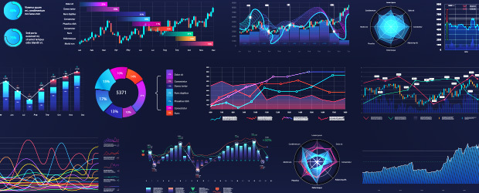

Data Preparation & Cleaning
Prior to analysis, the dataset required preparation for consistency and usability.
01
02
Timestamp Conversion
Missing Closure Dates
Standardized date and time formats.
Handled to distinguish open/unresolved complaints.
03
04
Derived Temporal Fields
Attribute Selection
Created fields like year, month, and hour.
Focused on relevant attributes for analytical objectives.

Slide 6





Methodology: EDA & Visual Storytelling
We adopted an Exploratory Data Analysis (EDA) methodology combined with interactive visual storytelling.
Initial Exploration
Complaint distributions and attribute completeness.
Temporal Aggregation
Identified trends and seasonal behavior.
Geographic Comparison
Across different boroughs.
Performance Analysis
Using complaint status and resolution times.
Dashboard Refinement
Iterative improvement for clarity.

Slide 7
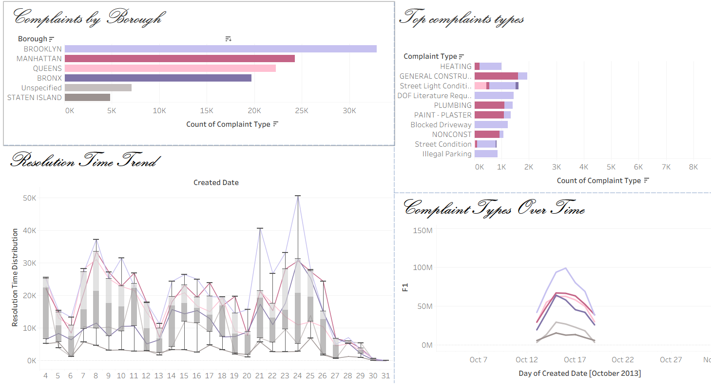

Dashboard Design & Structure
The visualization system is organized into three primary dashboards, each addressing a distinct analytical perspective.
1
2
Temporal Patterns
Geographic Distribution
Examines complaint volumes over time, trends, and fluctuations.
Compares complaint volumes across boroughs and analyzes status.
3
Behavioral Patterns
Investigates reporting activity by hour, month, and resolution times.

Slide 8
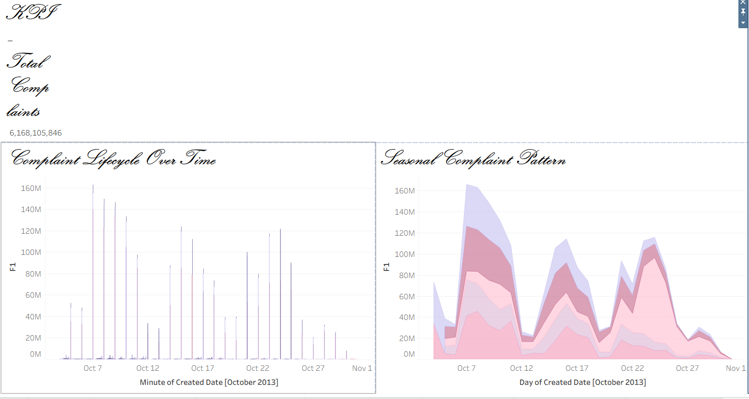
Key Performance Indicators (KPIs)
To support quick interpretation, the project includes key performance indicators that update dynamically.
Noise
1M+
90%
24h
Top Complaint
Service Requests
Closed Complaints
Avg. Resolution Time
Most frequently reported type.
Total number of complaints.
Percentage resolved.
Average time to resolve a complaint.

Slide 9
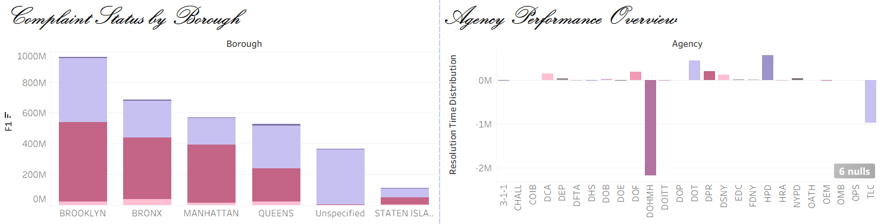




Tools and Technologies
A combination of robust tools supports analytical depth and professional presentation.
Tableau Public
Streamlit
Interactive dashboard creation and data exploration.
Web-based application for hosting dashboards.
Python
GitHub
Application integration and interface development.
Version control and deployment.

Slide 10




Conclusion: Insights for Urban Systems
This project demonstrates the value of interactive data visualization in analyzing large-scale civic datasets.
Meaningful Insight
Into urban service demand and operational behavior.
Flexible Exploration
User-driven analysis through interactive dashboards.
Better Understanding
How data analytics contributes to urban systems.

